Slide 1
UP ELECTIONS 2017 SENTIMENTAL ANALYTICS AND PREDICTION

Slide 2
PROJECT OVERVIEW
This project included downloading twitter data into R and performing analysis. The steps involved are: • Organizing the data and removing Stopwords, punctuations • Creating a glossary to monitor Hindi and English words • Structuring Wordclouds to identify the most commonly used words • Identifying positive and negative words and drawing trend lines to realize their usage and rate of recurrence in twitter data • Preparing a report on the conclusion and forecasting a winner based on the analysis

Slide 3
ELECTION LANDSCAPE
Following parties were included for the election landscape as they play a pivot role in elections:
Bharatiya Janata Party(BJP)
Indian National Congress+ Samajwadi Party (INC+SP)
Bahujan Samaj Party (BSP)
Predictions are made by analyzing approx. 20K tweets all taken together at various instances of time.

Slide 4
R-ANALYSIS

Slide 5
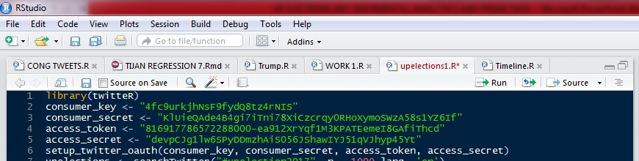
Setting Twitter Authentication
A twitter application by the name of “Anubhav94” was created and the necessary keys were generated. Using the R package “twitteR” we set up the necessary authentications for importing the twitter data into R environment.

Slide 6
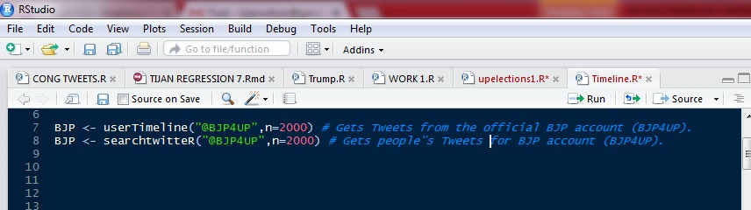
IMPORTING TWEETS :

Slide 7
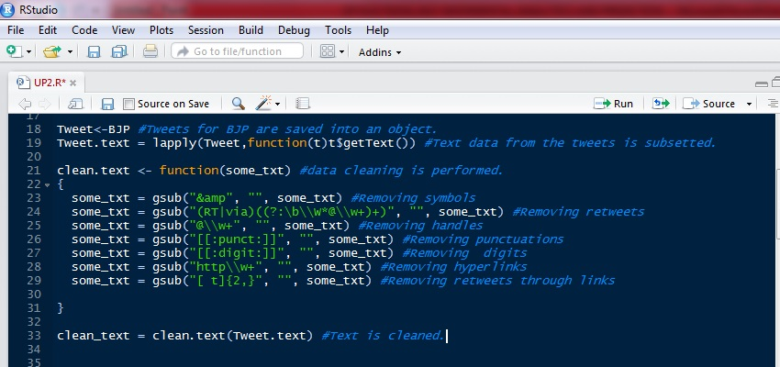
CLEANING THE DATA :

Slide 8
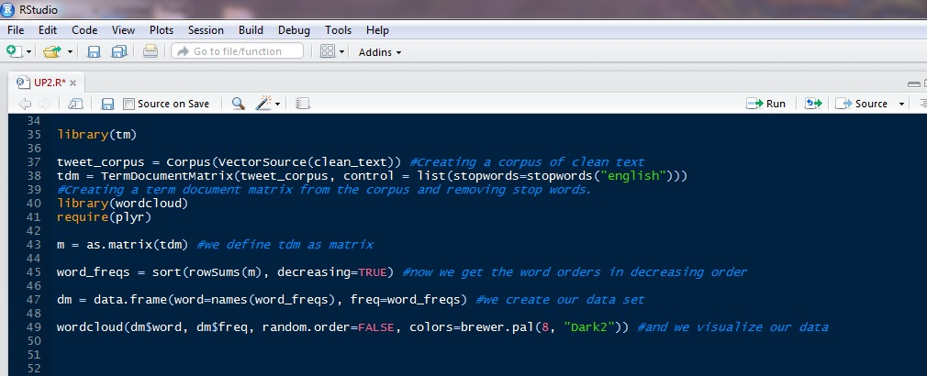
WORDCLOUD CREATION :

Slide 9
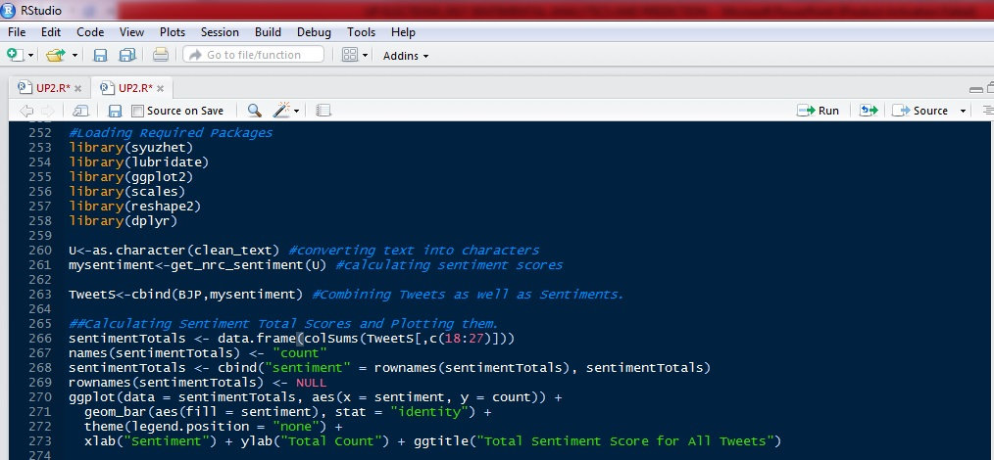
SENTIMENTAL SCORES :

Slide 10
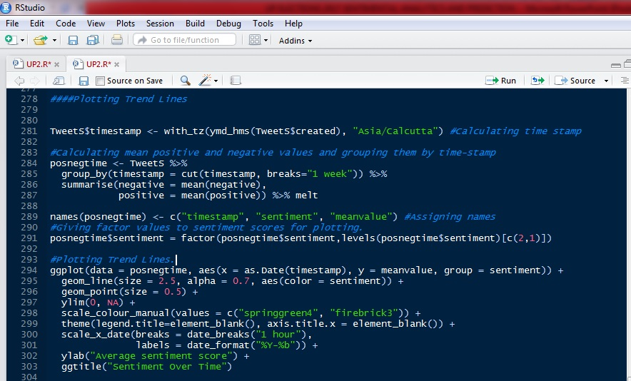
TRENDLINES :

Slide 11
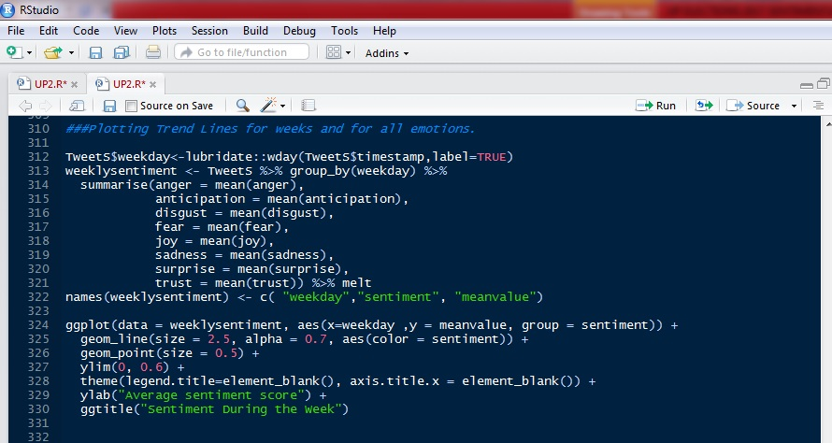
EMOTIONAL TRENDLINES :

Slide 12
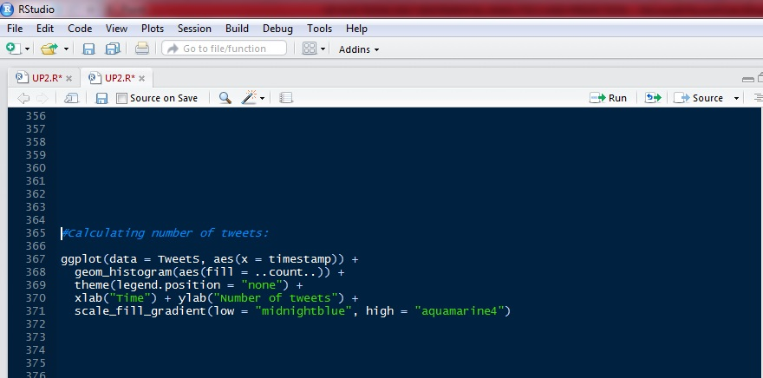
CALCULATING NUMBER OF TWEETS:

Slide 13
WORDCLOUD RESULTS

Slide 14
UP ELECTIONS :
This maps the sentimental shifts in the public perception for the UP Elections, indexed under #UPElections2017 and #UPPolls. Tweets are collected at differing intervals and their wordclouds are created. The following slides will contain the word clouds and sentiment trend lines.

Slide 15
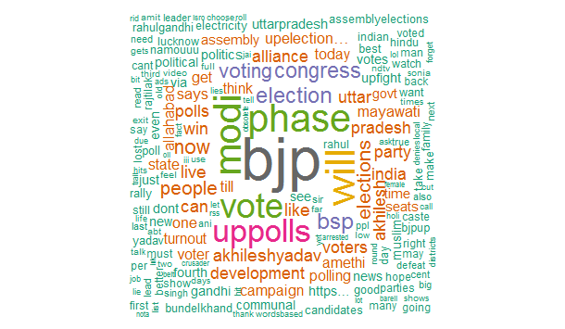
#UPElections2017
From the above word cloud, we see that “bjp” was the most frequently used string, which is indicative of people’s perception toward BJP and the fact that UP Elections and BJP have a prominent hold on people’s psyche. “modi” was also frequently mentioned in the tweets.

Slide 16
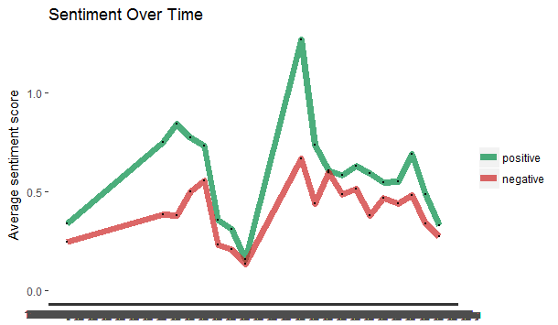
TRENDLINES :
We can see that when people tweeted about UP elections, the use of positive words was more than the use of negative words. Also, we know from the wordcloud that most frequently used words were ‘bjp’ and ‘modi’. So, we can infer that people used positive words for ‘bjp’ in context of U.P. elections.

Slide 17
@ANI NEWS UP
This maps the sentimental shifts in the public perception and news coverage for the UP Elections, indexed under #UPElections2017 and #UPPolls from the official ANI News UP twitter account. Tweets are collected at differing intervals and their wordclouds are created. The following slides will contain the word clouds and sentiment trend lines.

Slide 18
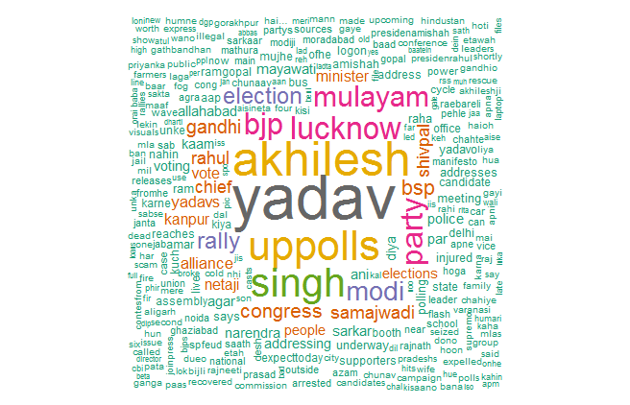
@ANI NEWS UP
From the above word cloud, it is evident that the incumbent party has been getting a lot of coverage, especially in the run-up to and during the elections. However, this maybe also attributable to the tussle within SP prior to the election.

Slide 19
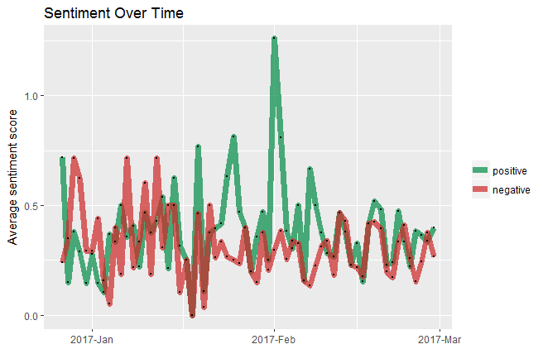
TRENDLINES (DAILY)
From the trend lines we see that the sentiment of the coverage during the elections by the news channel was overwhelmingly positive in February, but was moderately positive in the later part of the month, if mapped on a daily basis.

Slide 20
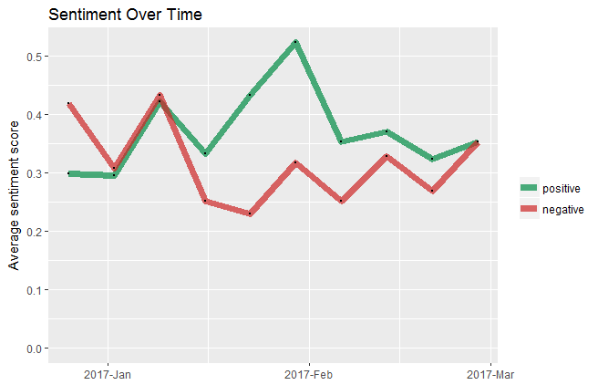
TRENDLINES (WEEKLY)
On a weekly basis, Coverage Sentiments were Significantly positively in February and as seen in the previous slide, the positivity reduced in later part of the month. Since Samajwadi party was most frequently covered by AniNews Up, we can infer that they tweeted in favour of the party.

Slide 21
BJP :
This maps the sentimental shifts in the public perception for BJP, during the UP Elections, indexed under #BJP4UP. Also, mapped are the sentiments of the face bearer of BJP , PM Narendra Modi by analyzing @narendramodi(official twitter account of PM Modi). Tweets are collected at differing intervals and their word clouds as well as sentiment trendlines are created. The following slides will contain the word clouds and sentiments.

Slide 22
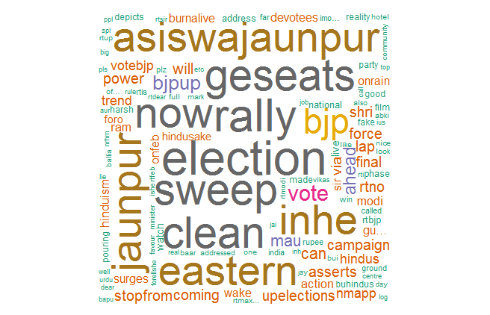
#BJP4UP
From the above word cloud we see that all the tweets indexed under, #BJP4UP reflects a high confidence regarding their chances in the ongoing election, as the words “election” and“sweep” are quite prevalent.

Slide 23
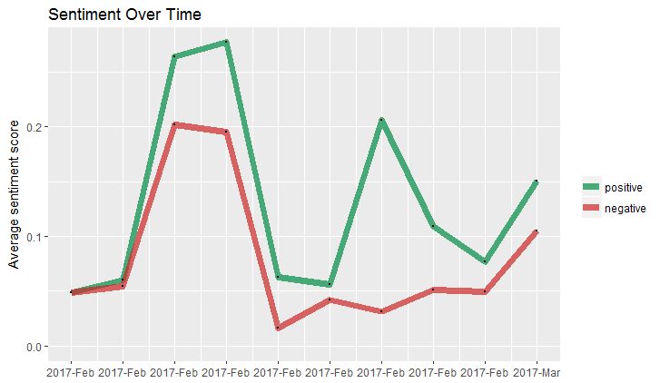
TRENDLINES :
From the above trend lines it is evident that during the peak of the election, the sentiment of the public using this hashtag was overwhelmingly positive and continues to remain so during the entire period. It is also registering a notable spike as the election reaches its final stretch. We could also observe a spike in the negative sentiment during the later part of February, which might be due to recent incident in Ramjas in which students protested against ABVP (student wing of BJP).

Slide 24
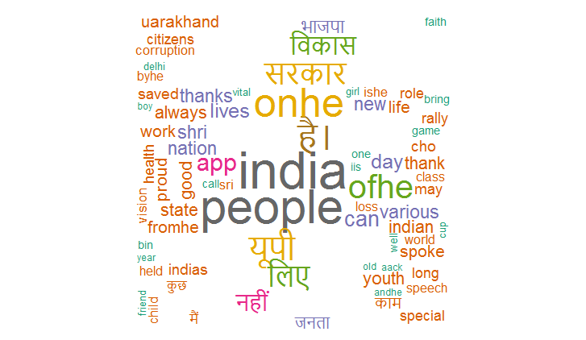
@narendramodi
From the above word cloud, we see that PM Modi is concerned about the country in general, as the strings “india” and “people” are the most prevalent. However, we see that he is also quite involved in the happenings of UP Elections 2017.

Slide 25
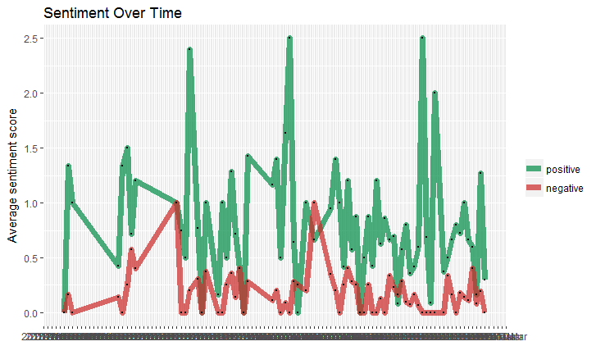
TRENDLINES : Daily
Narendra Modi’s Sentiment has largely been positive, if mapped on a daily basis.

Slide 26
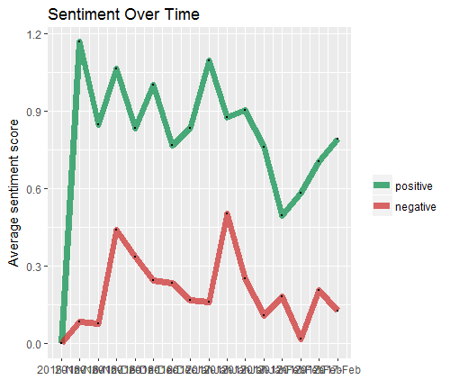
TRENDLINES : Weekly
Similarly, Sentiments on weekly basis are overwhelmingly positive. Use of negative words or thoughts quite less.

Slide 27
SAMJWADI PARTY :
This maps the sentimental shifts in the public perception for the UP Elections, indexed under #SAMAJWADI PARTY and tweets from @yadavakhilesh, the official twitter account of CM Akhilesh Yadav. Tweets are collected at differing intervals and their word clouds as well as sentiment trendlines are created. The following slides will contain the word clouds and trendlines.

Slide 28
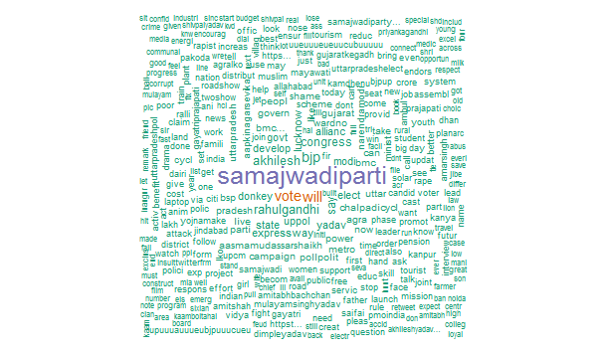
#SAMAJWADI PARTY :
From the above word cloud we see that the hashtag has been receiving focused tweets in favor of the SP-Congress alliance, and also has minimal interference or influence from rival mentions. Words like ‘power’ and ‘develop’ are used. Usage of Negative words like ‘donkey’ can also be seen.

Slide 29
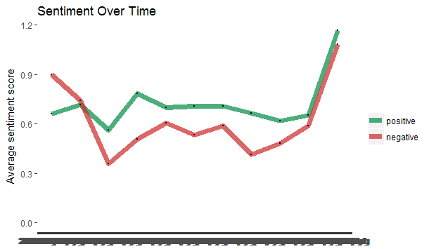
TRENDLINES :
The overall sentiment score of this hashtag remains positive and is seen spiking as the election progresses. This makes the SP-Congress alliance a strong contender. However, the negative score is also soaring during the final stages, which is a bad indicator. During the final stages the scores almost cancel out each other.

Slide 30
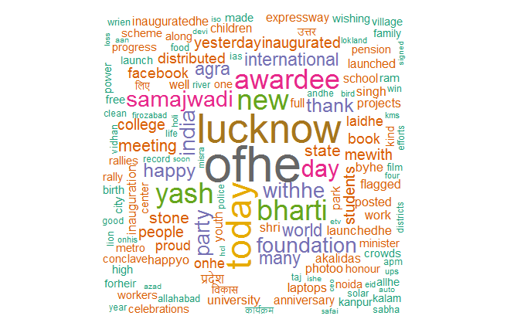
@yadavakhilesh
The tweets from CM Akhilesh Yadav seem to reiterate the promises made in his election manifesto without any explicit mention of the UP Elections.

Slide 31
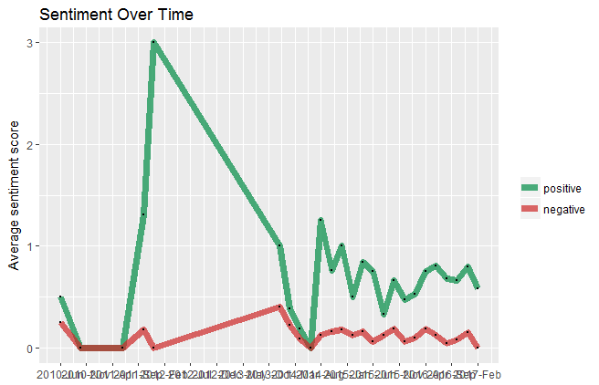
TRENDLINES :
Akhilesh Yadav has tried to stay positive. However, the difference between usage of positive and negative words is not significantly large.

Slide 32
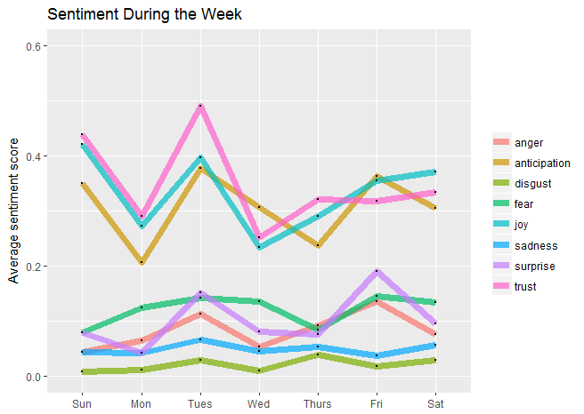
Akhilesh Emotions
During the week, Akhilesh’s Tweets have words which mostly emulate ‘trust’, ‘joy’ and ‘anticipation’. Emotion such as ‘disgust’ are avoided.

Slide 33
BSP :
This maps the sentimental shifts in the public perception for the UP Elections, indexed under #BSP. Tweets are collected at differing intervals and their word clouds are created. The following slides will contain the word clouds as well as, the trendlines.

Slide 34
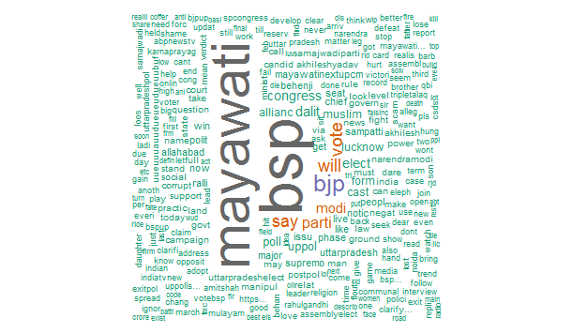
#BSP :
From the above word cloud, we see all the tweets indexed under #BSP and understandably, the strings “mayawati” and “bsp” are the dominant one’s. However, even here we see the prevalence of the strings “bjp” and “modi”. When people talk about #BSP, they often mention ‘muslims’ and ‘dalits’. This somehow shows the party’s target voters.

Slide 35
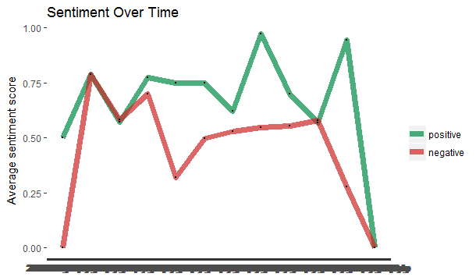
TRENDLINES :
From the above trend line for #BSP we see that the sentiments, both positive and negative have taken a steep downward slope, especially during the subsequent phases of the election, which leads us to conclude that its message is either not resonating or simply not getting through to the electorate. Thereby, rendering them not a serious contender. Also, difference between positive and negative scores has never been high.

Slide 36
TWEET FREQUENCY OF 2 MAIN LEADERS (MODI & AKHILESH )

Slide 37
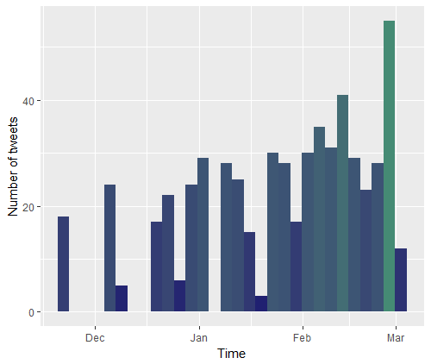
MODI :
PM Narendra Modi is known to be a tech savvy person and his reliance on social media is clearly evident from the frequency of his tweets which register a sharp spike during the months of February and March, the election months.

Slide 38
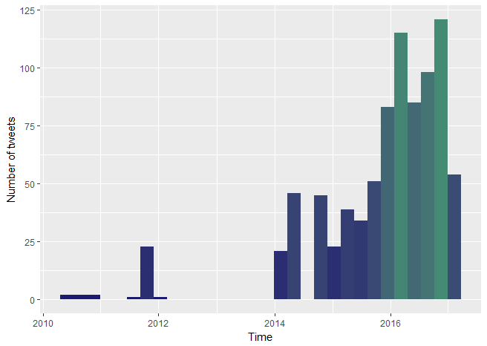
AKHILESH YADAV :
CM Akhilesh Yadav seems to be comparatively less tech savvy, however his tweets register a sharp spike in the run-up to to the election.

Slide 39
CONCLUSION:
From the above plotted trend lines we see that BJP has been gaining a lot of social media traction over its rivals: SP-Congress alliance and the BSP. Even though, we see that CM Akhilesh Yadav has been getting quite prevalent media coverage, we will still have to call this election in favor of BJP owing to their robust social media presence in both its own hashtags while also, featuring prominently on its rivals hashtags, which means that BJP has captured a major chunk of people’s psyche which boosts their electoral prospects. BJP’s positive scores as well their leader Narendra Modi’s are quite high.

